Slide 1


Jonathan Wright
13th September 2023

Slide 2

Outline
Executive Summary
Introduction
Methodology
Results
Conclusion
Appendix

Slide 3
Executive Summary
SpaceX competitor, SpaceY, has conducted a data science project investigating SpaceX’s past launches in order to determine if a predictive model can be identified to help predict whether future launches will be successful, and thus, help predict how much these launches will cost.
Data on past launches has been collected via SpaceX’s API and web scraped from Wikipedia, before being run through EDA using Data Visualization packages and SQL. Additional data visualization packages (Plotly, and Dash) were used to for further data visualizations.
Four classification models were investigated, which yielded similar predictive accuracies, with the Decision Tree Classifier yielding the best accuracy.
This suggests that it is possible to use prior launch data to develop a predictive model for future launches.

Slide 4
Introduction
SpaceX has accomplished the feat of re-using spacecraft by landing them, drastically reducing the cost of space travel. These launches are not fool-proof however, and do have a success rate based on a number of factors.
A competing rocket manufacturer wants to analyze SpaceX’s past successful and failed launches to identify whether predictions can be made on the success of future launches without the use of rocket science, and thus, help predict how much future launches will cost.
Can past launch factors be used to develop a predictive model for the success of future launches?
What features will be required to model this?
What factors lead to a lower launch success rate?

Slide 5

Section 1

Slide 6
Methodology
Executive Summary
Data collection methodology:
Data will be collected via open API and via web scraping Wikipedia
Perform data wrangling
Data will be processed by using Pandas and NumPy Python packages
Perform exploratory data analysis (EDA) using visualization and SQL
Perform interactive visual analytics using Folium and Plotly Dash
Perform predictive analysis using classification models
4 Different classification models will be investigated and compared to identify the best performing model
Logistic Regression, SVM, KNN, and Decision Tree Classifier

Slide 7
Data Collection
Data was collected from 2 key sources:
SpaceX API URL
Collected via Python Requests package
Web Scraped from Wikipedia
Collected via Python Requests package
Parsed using BeautifulSoup

Slide 8
Data Collection – SpaceX API
The requests module in Python is used to get a JSON response from the SpaceX API URL, which is parsed to a Pandas DataFrame using the json_normalize() function.
Formatting is then performed on the data (Subset of data before 13th November 2020, and only data with single cores and payloads).
Pre-defined functions are then used to append key data to new lists, which are then used to build a new dataset called launch_dict.
This new dataset is then filtered to focus on only Falcon 9 launches
Data wrangling is then used to deal with missing values, which are replaced by the column means before the data is exported to a csv
https://github.com/jonwright13/ibm-applied-data-science-capstone/blob/main/Week%201%20-%20Lab%201%20-%20Collecting%20the%20data.ipynb
API GET Call
↓
Data Formatting
↓
Data Transforming
↓
Data Wrangling (Missing Values)
↓
Export to CSV

Slide 9
Data Collection - Scraping
The response package in Python is used to retrieve the HTML text from a static URL, which is then parsed using the BeautifulSoup package.
Columns and variables names are then extracted from the HTML table header.
A Pandas DataFrame is then created by parsing the HTML tables before it is exported to a CSV.
https://github.com/jonwright13/ibm-applied-data-science-capstone/blob/main/Week%201%20-%20Lab%202%20-%20Webscraping%20from%20Wikipedia.ipynb
HTML Extracted from Static URL
↓
HTML Parsed with BeautifulSoup
↓
Columns / Variable Names Extracted
↓
DataFrame Parsed from HTML Tables
↓
CSV Export

Slide 10
Data Wrangling
Data is analyzed through several methods to:
Calculate the number of launches per site
Calculate the number of an occurrence of each orbit
Calculate the number of and occurrence of each mission outcome per orbit
The categorical column ‘class’ is converted into numerical values to represent good and bad outcomes as 1 and 0 respectively.
Data is exported to a CSV
https://github.com/jonwright13/ibm-applied-data-science-capstone/blob/main/Week%201%20-%20Lab%203%20-%20Data%20Wrangling.ipynb

Slide 11
EDA with Data Visualization
List of Charts Plotted and Why:
Scatter Chart:
Task 1: To visualize the relationship between Flight Number and launch site
Task 2: To visualize the relationship between payload and launch site
Task 4: To visualize the relationship between Flight Number and Orbit type
Task 5: To visualise the relationship between payload and orbit type
Bar Chart:
Task 3: To visualize the relationship between success rate and orbit type
Line Chart:
Task 6: To visualize the launch success yearly trend
https://github.com/jonwright13/ibm-applied-data-science-capstone/blob/main/Week%202%20-%20Lab%202%20-%20EDA%20with%20Pandas%20%26%20Visualisations.ipynb

Slide 12
EDA with SQL
The selection of SQL queries performed on the data are:
Creating a table in the database for the SpaceX data and populating records where date is not null
Displaying unique (Distinct) launch sites
Displaying only 5 records for a specific launch site
Display total (Sum) payload mass carried by a specific customer
Display the average payload mass by a specific booster version
List the date of the first successful landing outcome in ground pad
List the names of the boosters, which have seen success in the drone ship launch site, with a specific payload mass range
List the total number of successful and failed mission outcomes
List the booster versions, which have carried the max payload mass (Sub-Query)
List records contained failed landing outcomes at drone ship, along with specific columns and parsed dates
Rank the landing outcomes between specific dates in descending order
https://github.com/jonwright13/ibm-applied-data-science-capstone/blob/main/Week%202%20-%20Lab%201%20-%20SQL%20Exploratory%20Data%20Analysis.ipynb

Slide 13
Build an Interactive Map with Folium
Created Map Objects:
Circle is created with color #d35400 around NASA Johnson Space Center
Marker is added to NASA Johnson Space Center with an icon displaying the name
A series of circles and markers are then added to all the launch sites to mark them on the map clearly
A marker cluster is used to mark the location of all the individual launches with a color denoting their success (Green) or failure (Red)
PolyLines are drawn on the map to mark/calculate distance between launch sites and specific locations (Coastline, railway station, city, highway)
https://github.com/jonwright13/ibm-applied-data-science-capstone/blob/main/Week%203%20-%20Lab%201%20-%20Launch%20Sites%20Locations%20Analysis%20with%20Folium.ipynb

Slide 14
Build a Dashboard with Plotly Dash
Plots/Graphs and interactions added to dashboard:
Pie Chart: -> To visualize categorical success/failure data
Displays all launch sites and % of successful launches
Displays a specific launch site with 2 sections representing success/failure of launch
Scatter Chart: -> To visualize correlation of categorical success/failure data
Displays the correlation between payload and success for all launch sites
Displays the correlation between payload and success for a specific launch site
https://github.com/jonwright13/ibm-applied-data-science-capstone/blob/main/Week%203%20-%20Web%20App%20Dashboard%20with%20Dash.py

Slide 15
Predictive Analysis (Classification)
ML Models were built by first mapping the class column to Y, and a fit_transformed features to X before being split into test/train sets
GridSearchCV was used across several model types using pre-set parameters to train, predict, and identify tuned hyperparameters, accuracy, and a confusion matrix for each:
Logistic Regression, Support vector Machine (SVM), Decision Tree Classifier, and K-Nearest Neighbors Classifier
All models performed practically the same using test data; however, the decision tree classifier had the best accuracy on the training data, at 87.7% while the others had slightly below this.
https://github.com/jonwright13/ibm-applied-data-science-capstone/blob/main/Week%204%20-%20Lab%201%20-%20Building%20The%20Models.ipynb
Fit_Transform X and map Y
↓
GridSearchCV Logistic Regression
↓
GridSearchCV SVM
↓
GridSearchCV Decision Tree Classifier
↓
GridSearchCV KNN
↓
Calculate Train/Test Accuracy of each model and compare

Slide 16
Results
Launch success has been increasing steadily year on year since start in 2013 regardless of other factors
Launch site KSC LC-39A has the highest number of successful launches compared to all other sites (Nearly 50 of all successful launches came from here), while site CCAFS SLC-40 has the lowest number of successful launches
Launch site KSC LC-39A has a 77% success rate, indicating a very high chance of future launches here being successful
Orbit SSO has a 100% success rate but limited launches, while orbit GTO has a higher number of launches but does see some failures with repeated failures after a single occurrence.
LEO Orbit shows the best repeated success with no failures after the first 2 launches
All 4 machine learning models discussed revealed similar test accuracies (83.33%), whilst the decision tree classifier presented a slightly higher training accuracy (87%)
This suggests the Tree classifier should be used to predict whether future launches are successful based on launch site, booster version, orbit, and payload

Slide 17

Section 2

Slide 18
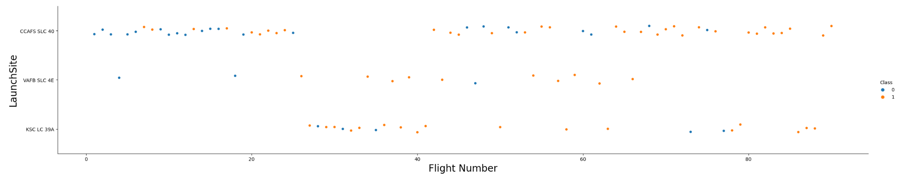
Flight Number vs. Launch Site
Show a scatter plot of Flight Number vs. Launch Site
Scatter plot shows successive / failed launches (Denoted by class color) for all flight numbers
There is a lower number of failed launches (Blue) compared to Successful launches (Orange).
A single failed launch at CCAFS SLC-40 usually follows or precedes another failed launch at this site (Not isolated), while failures at KSC LC 39A are generally moreso

Slide 19
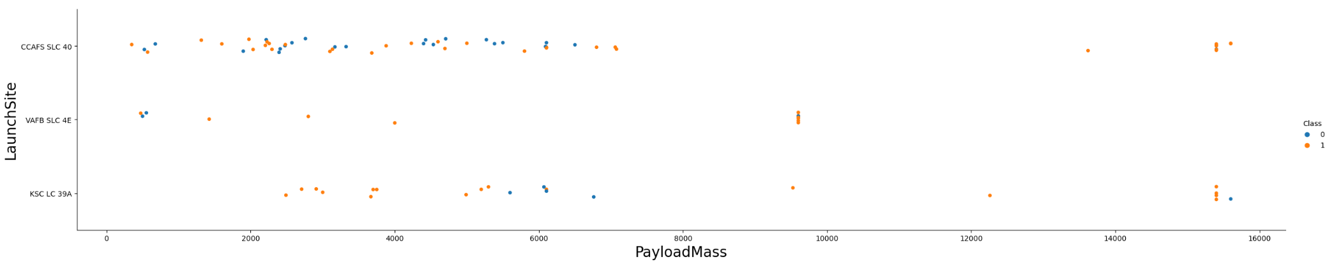
Payload vs. Launch Site
Show a scatter plot of Payload vs. Launch Site
Scatter plot shows that launch site VAFB SLC 4E does not accommodate payloads above 10,000kg

Slide 20
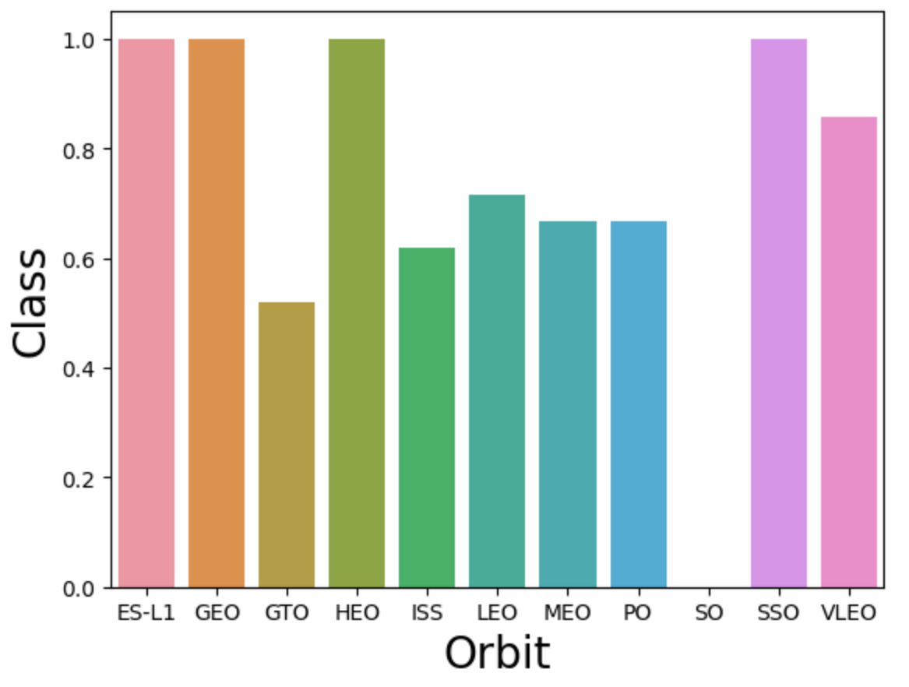
Success Rate vs. Orbit Type
Show a bar chart for the success rate of each orbit type
Bar chart shows that some orbits had a high success rate compared to others

Slide 21
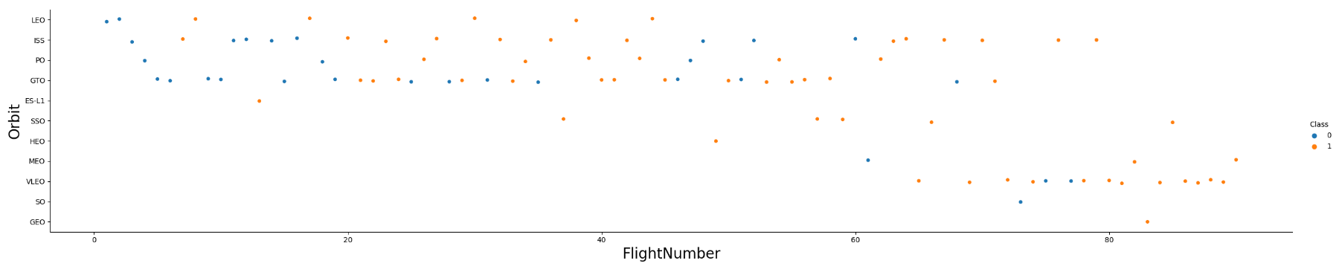
Flight Number vs. Orbit Type
Show a scatter point of Flight number vs. Orbit type
Scatter plot shows orbit LEO took 2 failed launches before being successful every time afterwards, while other orbits had varying successes and failures
Orbit SSO showed all successes but with limited frequency

Slide 22
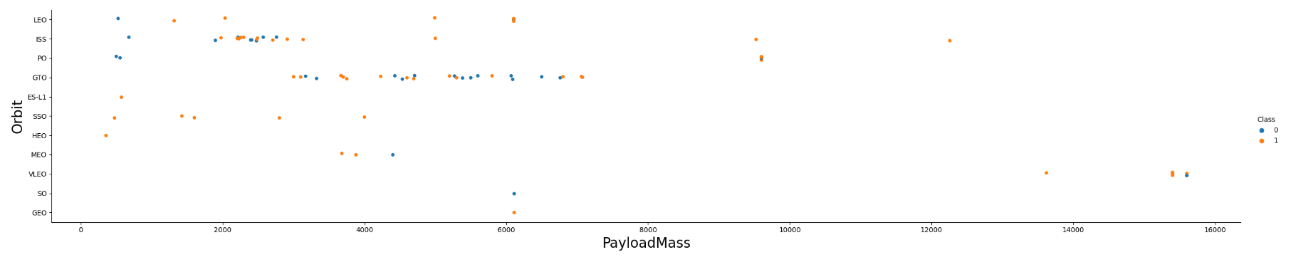
Payload vs. Orbit Type
Show a scatter point of payload vs. orbit type
Scatter chart shows a high frequency of low payloads across most orbits, while higher payloads are less frequent and only used in specific orbits

Slide 23
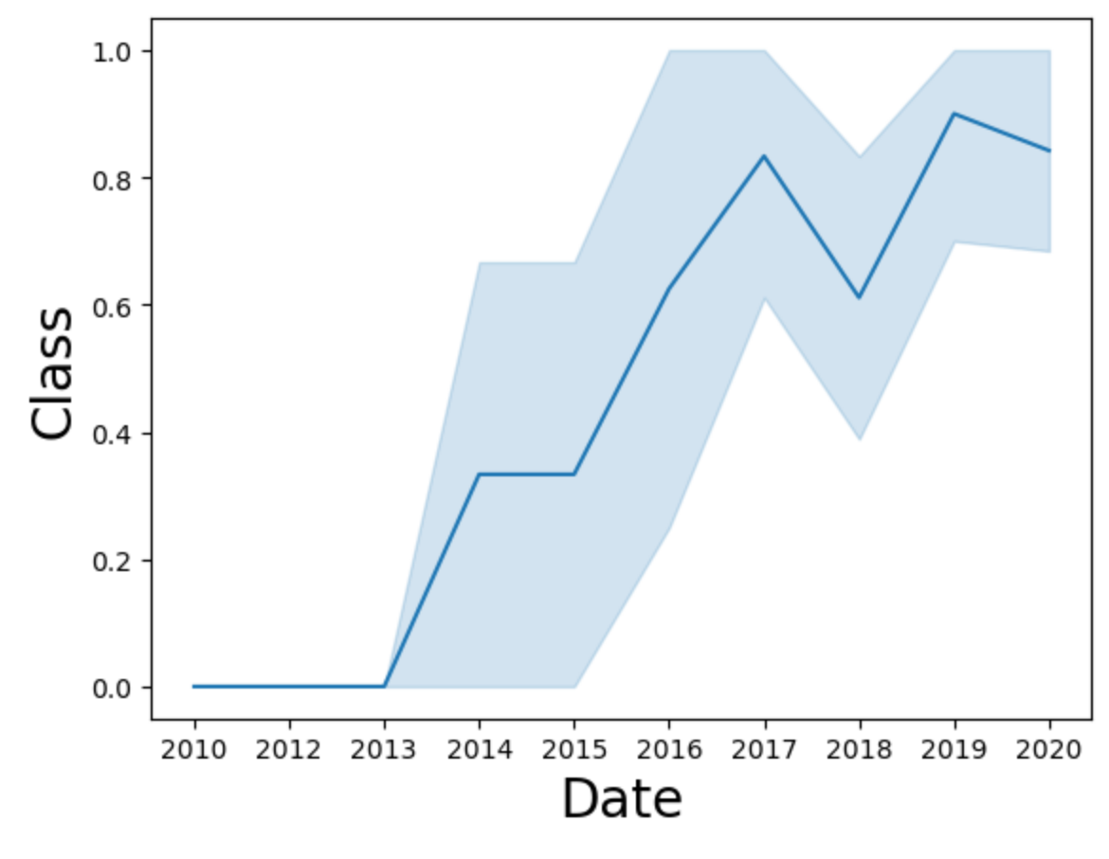
Launch Success Yearly Trend
Show a line chart of yearly average success rate
Line chart shows that successful launches increase year on year up till 2020

Slide 24
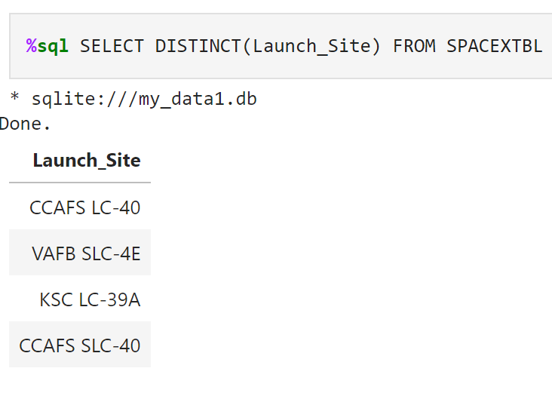
All Launch Site Names
Find the names of the unique launch sites
SQL SELECT statement used to return distinct launch site names from table

Slide 25
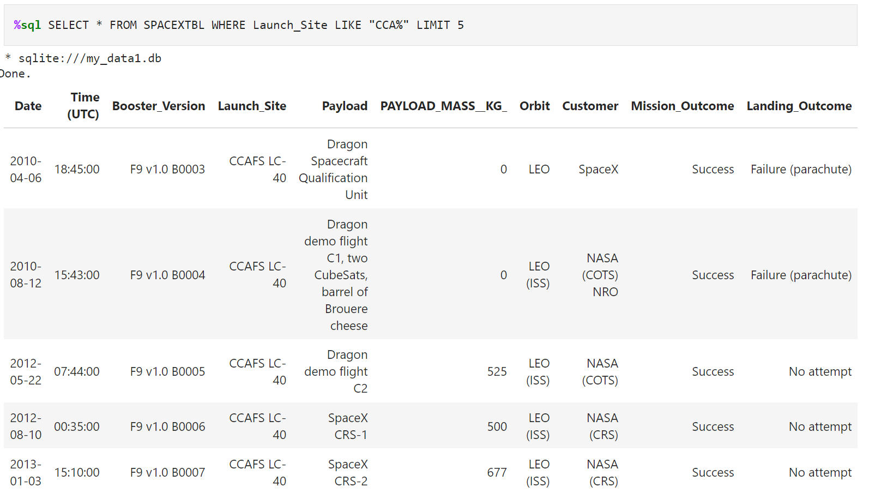
Launch Site Names Begin with 'CCA'
Find 5 records where launch sites begin with `CCA`
SQL SELECT statement used to return all columns from table WHERE the string “%CCA%” occurs in the launch site name, limited to the first 5 records

Slide 26
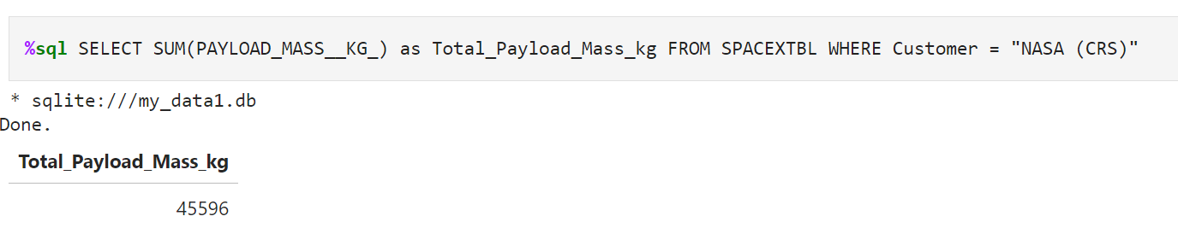
Total Payload Mass
Calculate the total payload carried by boosters from NASA
SQL SELECT statement used to sum up the payload columns with a specific cutomer (NASA)

Slide 27
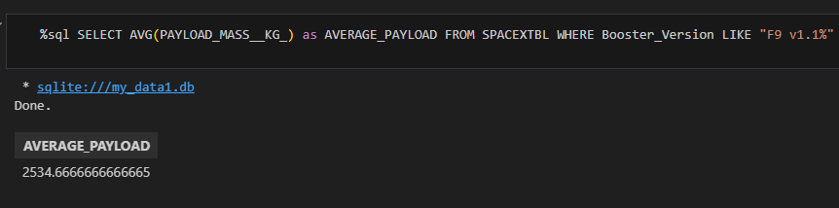
Average Payload Mass by F9 v1.1
Calculate the average payload mass carried by booster version F9 v1.1
SQL SELECT statement used to identify the average payload mass, achieved using a WHERE predicate

Slide 28
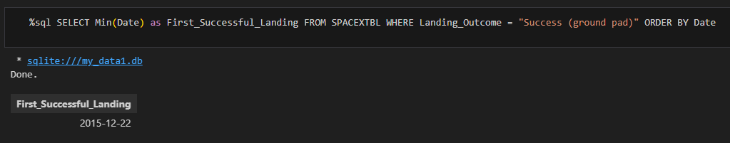
First Successful Ground Landing Date
Find the dates of the first successful landing outcome on ground pad
SQL SELECT statement used to find the min date with a WHERE predicate and ordered by date

Slide 29
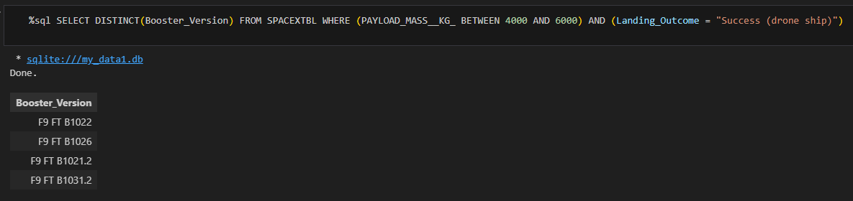
Successful Drone Ship Landing with Payload between 4000 and 6000
List the names of boosters which have successfully landed on drone ship and had payload mass greater than 4000 but less than 6000
SQL SELECT query displays only the distinct booster versions which had a specific payload and landing outcome, achieved using a WHERE predicate

Slide 30
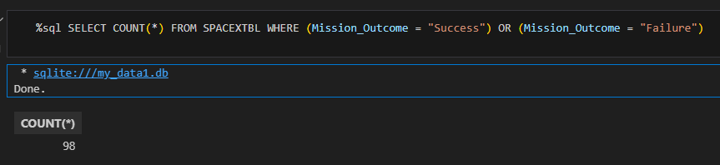
Total Number of Successful and Failure Mission Outcomes
Calculate the total number of successful and failure mission outcomes
SQL SELECT statement counts the number of failed or successful mission outcomes, achieved using a WHERE predicate

Slide 31
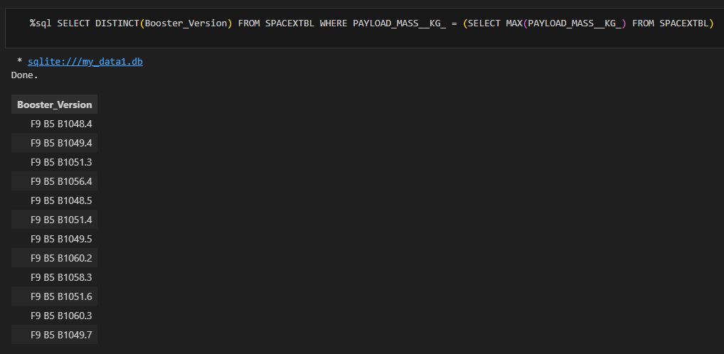
Boosters Carried Maximum Payload
List the names of the booster which have carried the maximum payload mass
SQL SELECT statement used to return only the distinct booster versions which had a max payload mass
Sub-query used to identify the max payload mass

Slide 32
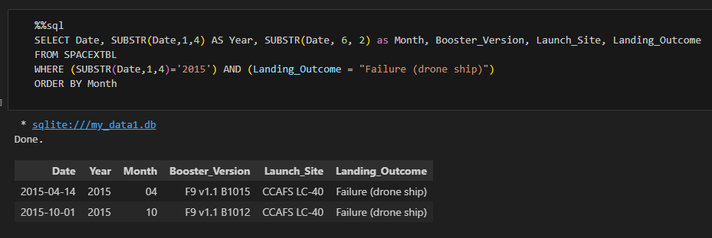
2015 Launch Records
List the failed landing_outcomes in drone ship, their booster versions, and launch site names for in year 2015
SQL SELECT query converts date values into year and month in separate columns
Booster version, launch site, and landing outcome are the parsed into a table, orderd by month, where the year is 2015 with a specific landing outcome

Slide 33
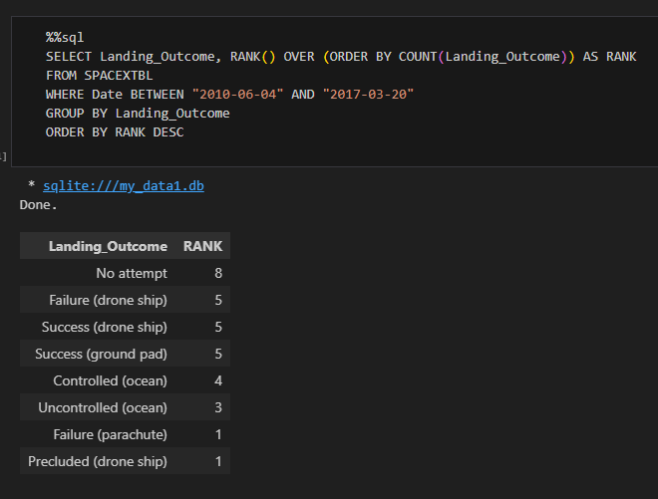
Rank Landing Outcomes Between 2010-06-04 and 2017-03-20
Rank the count of landing outcomes (such as Failure (drone ship) or Success (ground pad)) between the date 2010-06-04 and 2017-03-20, in descending order
SQL SELECT query that presents 2 columns showing all the distinct landing outcomes and their rank in descending order
Where clause used to only specify landing outcomes between specific dates

Slide 34

Section 3

Slide 35

Folium Map of All SpaceX Launch Sites
Zoomed out Folium Map showing the entirety of the USA with orange markers denoting the launch sites in Florida and California

Slide 36
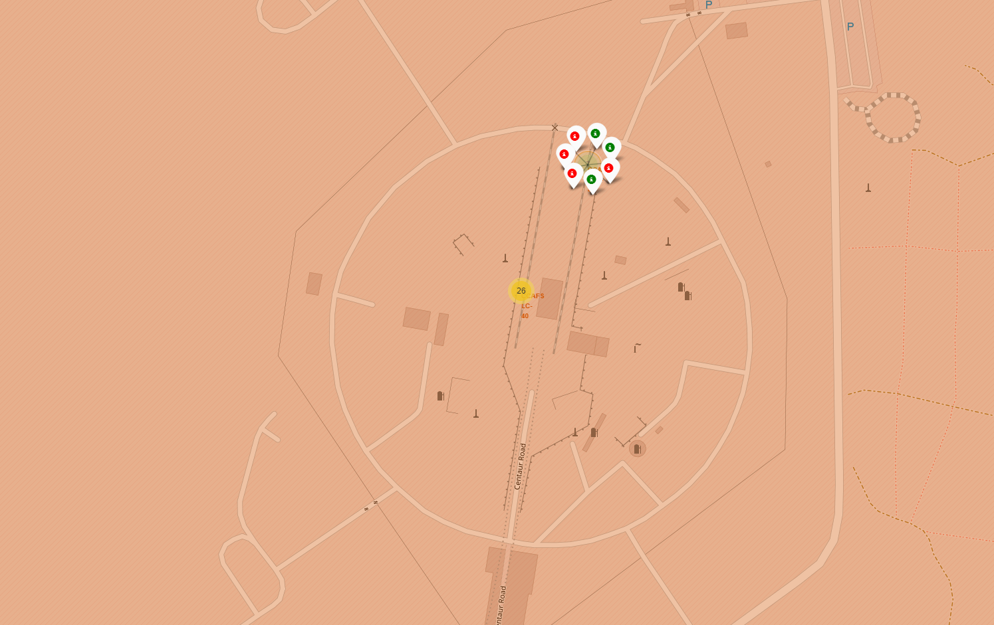
Folium Map of Success/Failed Launches at Site CCAFS SLC-40
Zoomed in Folium map showing launch site CCAFS SLC-40 with individual markers (Marker Cluster) showing each launch with a color denoting the class (Success or failure in green / red respectively)

Slide 37
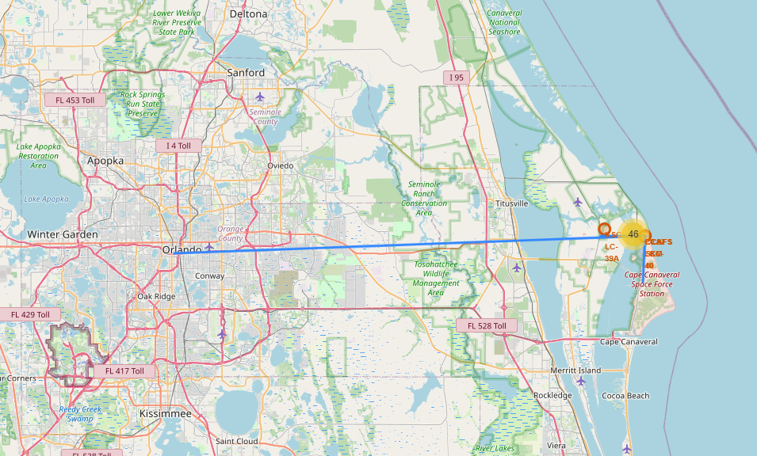
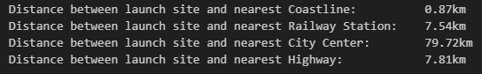
Folium Map of Launch Site CCAFS SLC-40 & Proximity to Infrastructure
Folium map to right showing proximity to launch site CCAFS SLC-40 from key infrastructure denoted with a blue PolyLine (City of Orlando, Railway Station, Highway, and Coastline)
Numerical distances shown below

Slide 38

Section 4

Slide 39
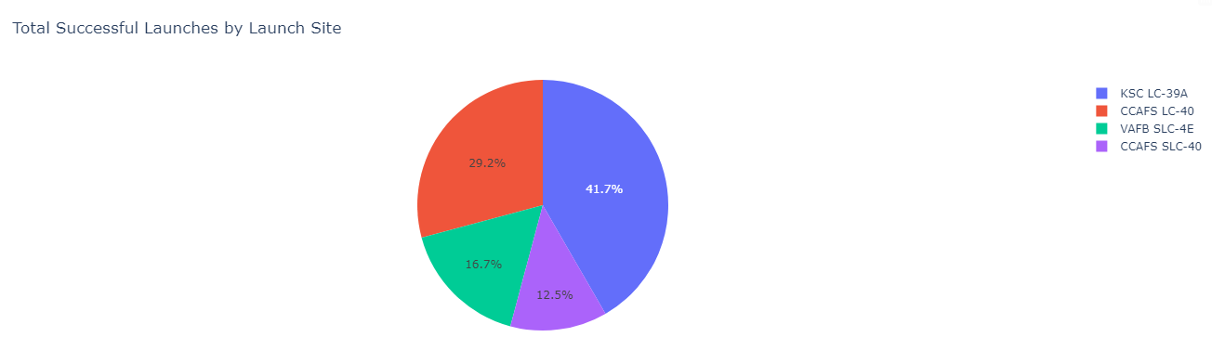
Dashboard Launch Success Count Pie Chart
Show the screenshot of launch success count for all sites, in a piechart
Chart shows that site KSC LC-39A has the highest number of successful launches with nearly 50% of all successful launches coming from this site compared to the others, with CCAFS LC-40 coming in second.
Site CCAFS SLC-40 has the lowest number of successful launches

Slide 40
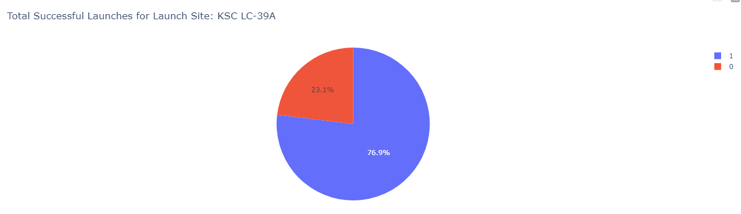
Dashboard Pie Chart of Site KSC LC-39A
Show the screenshot of the piechart for the launch site with highest launch success ratio
Site KSC LC-39A showed the highest number of successful launches compared to all other sites, and when selected, shows that over ¾ of launches there were successful

Slide 41
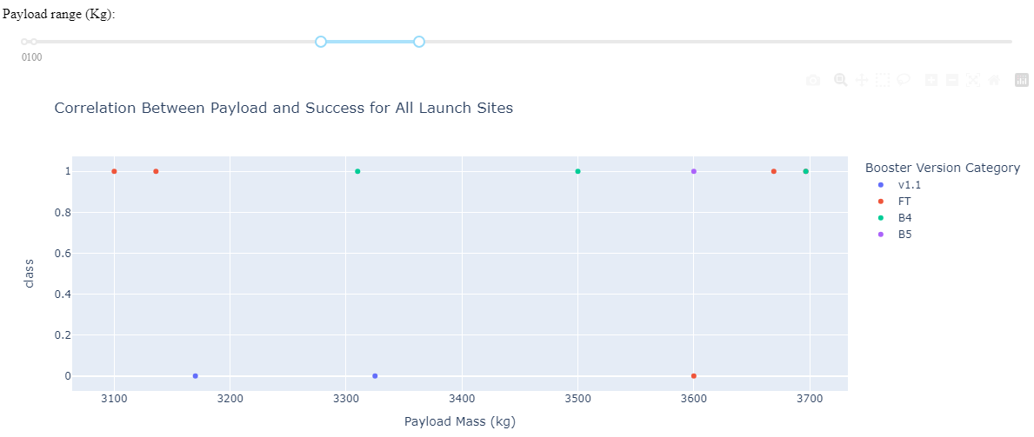
Dashboard Correlation Between Payload & Success
Show screenshots of Payload vs. Launch Outcome scatter plot for all sites, with different payload selected in the range slider
Scatter plot shows booster versions, success/failures, and payloads between 3000kgand 4000kg.
In this range, booster category had the best successful launches within this payload range, with B4 coming in second

Slide 42

Section 5

Slide 43
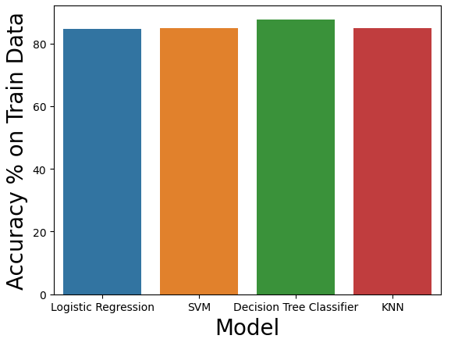
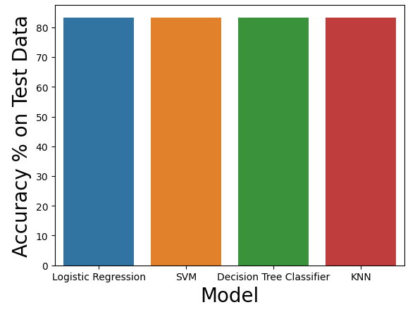
Classification Accuracy
Visualize the built model accuracy for all built classification models, in a bar chart
Accuracy of all 4 models displayed on right for both test and train data in bar charts
Find which model has the highest classification accuracy
All 4 models perform the same with test data, but the decision tree classifier has a slightly higher accuracy on training data than other models

Slide 44
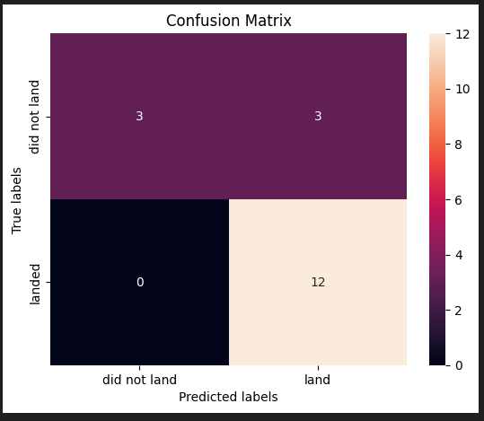
Confusion Matrix
Confusion Matrix for the Decision Tree Classifier Model
All models performed similarly with test data, but only the Tree model showed improvements compared with other models for the training data

Slide 45
Conclusions
Launch success has been increasing steadily year on year since start in 2013 regardless of other factors
Launch site KSC LC-39A has the highest number of successful launches compared to all other sites (Nearly 50 of all successful launches came from here), while site CCAFS SLC-40 has the lowest number of successful launches
Launch site KSC LC-39A has a 77% success rate, indicating a very high chance of future launches here being successful
Orbit SSO has a 100% success rate but limited launches, while orbit GTO has a higher number of launches but does see some failures with repeated failures after a single occurrence.
LEO Orbit shows the best repeated success with no failures after the first 2 launches
All 4 machine learning models discussed revealed similar test accuracies (83.33%), whilst the decision tree classifier presented a slightly higher training accuracy (87%)
This suggests the Tree classifier should be used to predict whether future launches are successful based on launch site, booster version, orbit, and payload

Slide 46
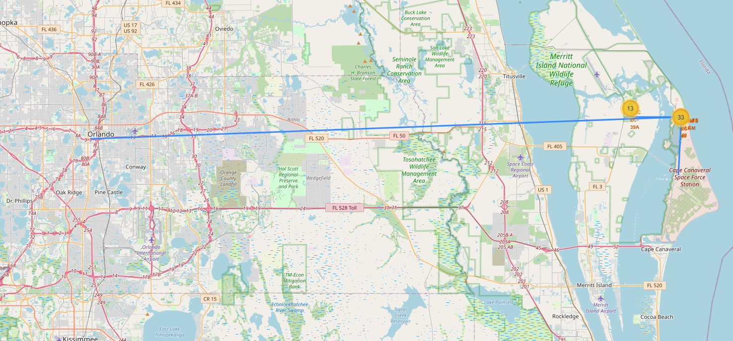
Appendix
Launch sites KSC LC-39A and CCAFS SLC-40 are both very close together but have distinctly different success rates, possibly due to proximity to coastline
Wind flow from the sea could be a factor explaining the differences, as KSC LC-39A is more in-land and shielded, whilst CCAFS SLC-40 is less than 1km from the coast

Slide 47


